Slide 1
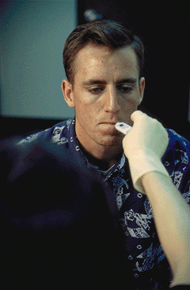



Session 7
Examination
of Vital Signs

Slide 2
Learning Objectives
Explain purposes of vital signs examinations
Explain procedures for these examinations
Explain the indicators for these examinations
Document examinations of vital signs

Slide 3
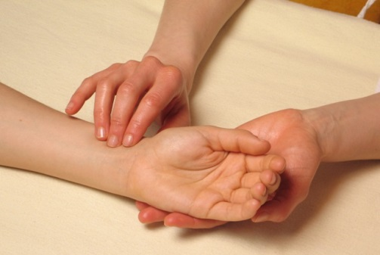
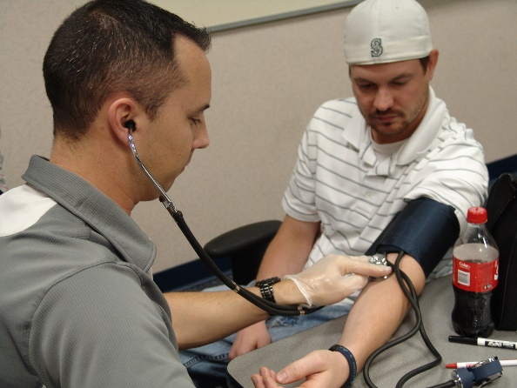
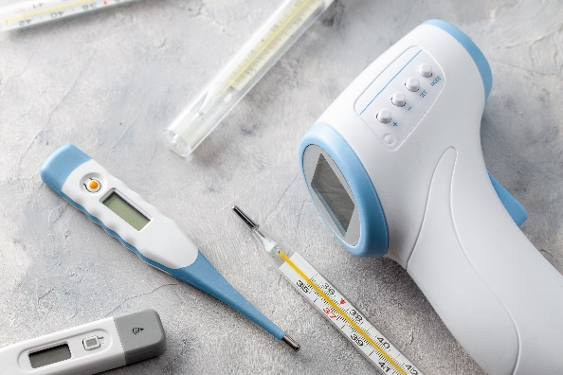
Drug Influence Evaluation Vital Signs
Pulse Rate
Blood Pressure
Temperature

Slide 4
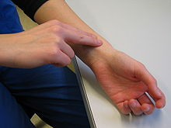
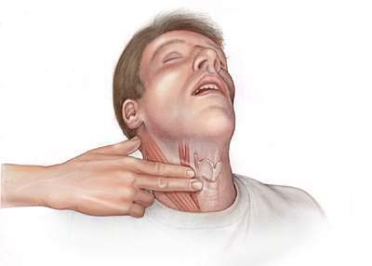
Definitions Concerning “Pulse”
Pulse
Pulse Rate
Artery
Vein

Slide 5
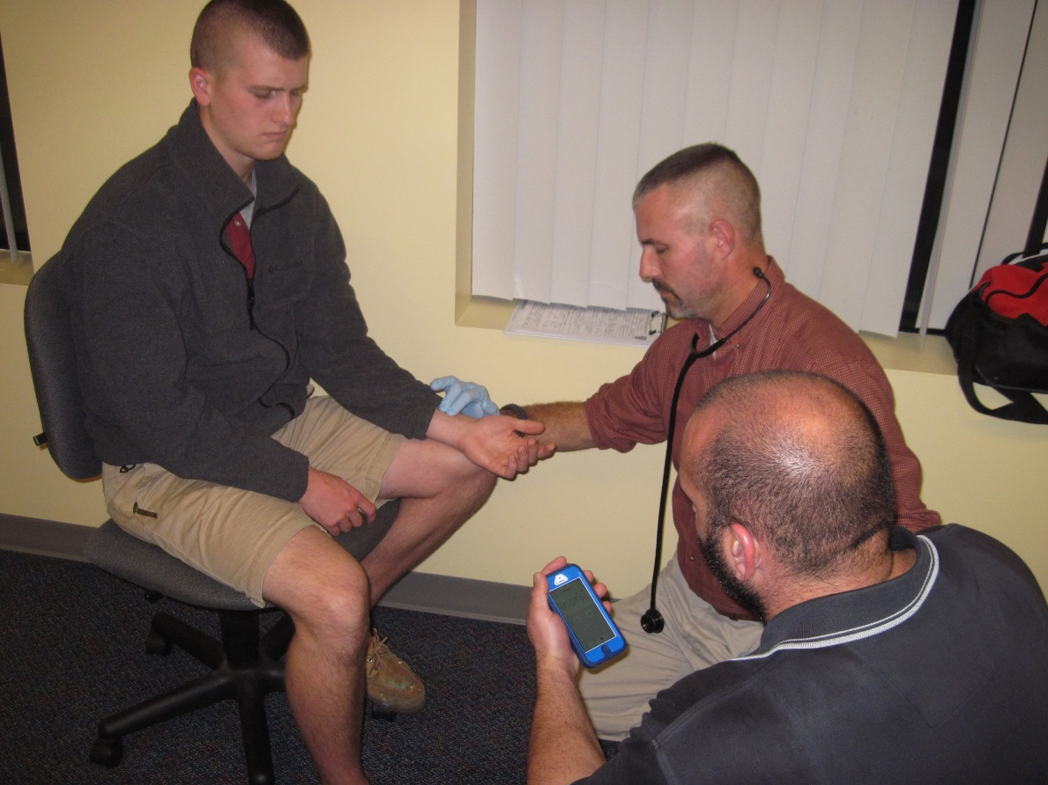
Radial Artery Pulse Point
Subject’s wrist position can be up or down

Slide 6
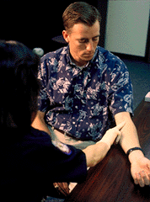

Brachial and Carotid Artery Pulse Points

Slide 7
Proper Procedures of Measuring Pulse
Don’t use your thumb to apply pressure while measuring a subject’s pulse
When measuring the pulse rate, use time intervals of 30 seconds

Slide 8
Pulse Rate Technical Terms
Tachycardia – abnormally rapid heart rate
Bradycardia – unusually slow heart rate
Arrhythmia – abnormal heart rhythm

Slide 9
Blood Pressure
Millimeters of Mercury = mmHg
Systolic Pressure
Diastolic Pressure

Slide 10
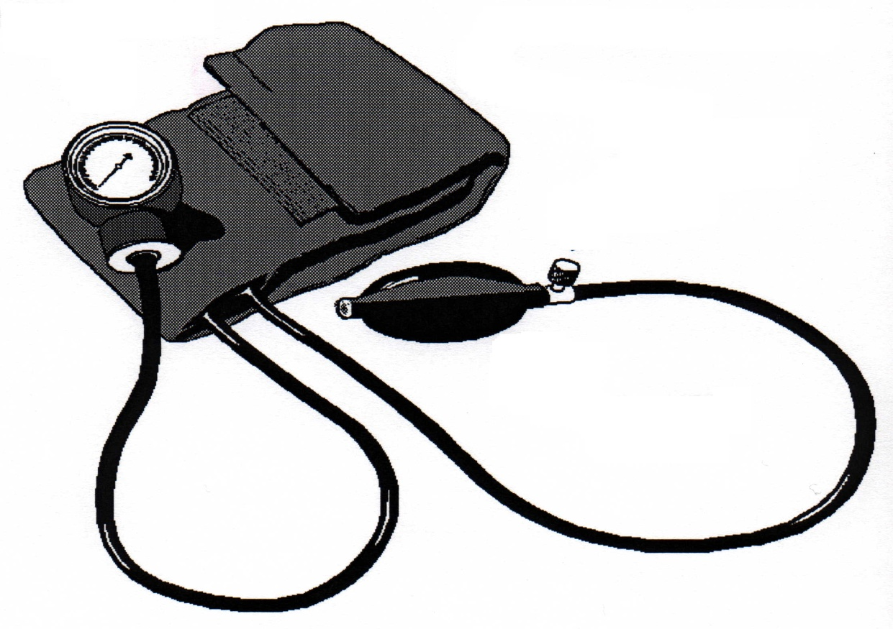
Sphygmomanometer
MANOMETER
(Pressure Gauge)
COMPRESSION
CUFF
PRESSURE
CONTROL
VALVE
TUBES
PRESSURE
BULB

Slide 11
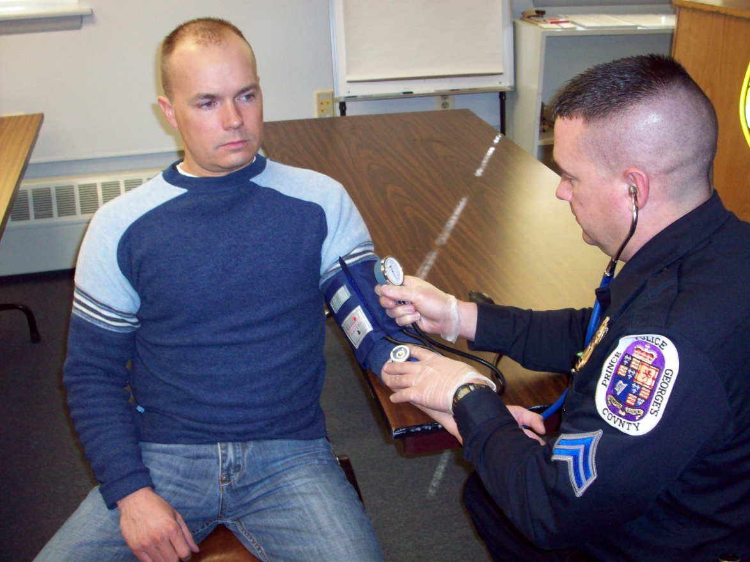
The Basics of Blood Pressure Measurement

Slide 12

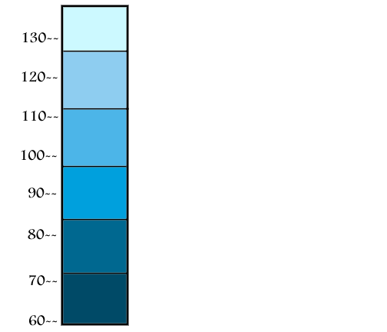
Korotkoff Sounds
Phase 1 begins Systolic
Clear, tapping sounds
Click Icon to Play
Phase 2 begins
Sounds change to murmur,
take on a “swishing” quality
Phase 3 begins
Sounds develop a loud,
knocking quality
Phase 4 begins
Sounds become muffled, faint
“swishing” quality
Phase 5 begins Diastolic
The sounds cease
Click Icon to Play

Slide 13
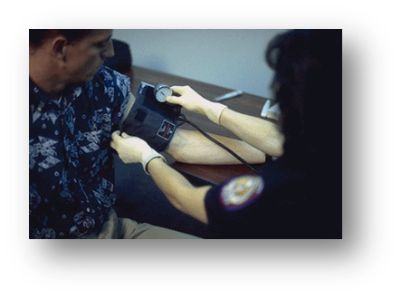
Proper Procedures of Blood Pressure Measurement

Slide 14
Measurement of Temperature

Slide 15
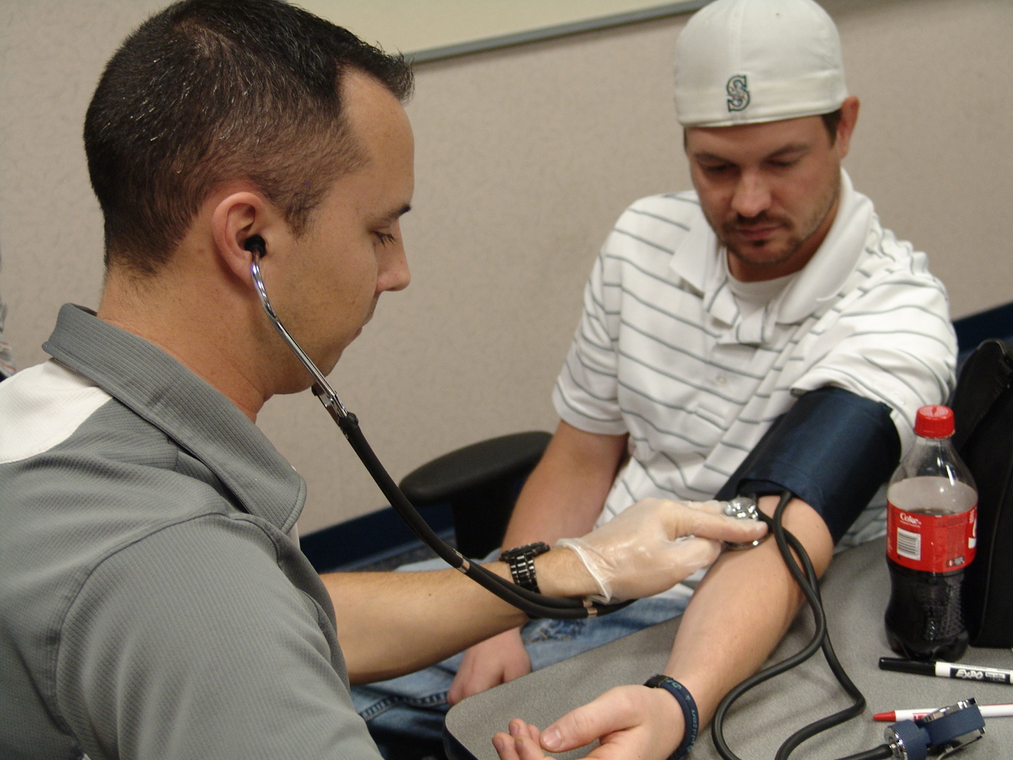
Demonstrations/Practice

Slide 16
Questions?

Slide 17
Test Your Knowledge
Where is the Radial Artery pulse point?
Why should you never attempt to feel a subject’s pulse with your thumb?
Does an artery carry blood to the heart or from the heart?
What does the symbol “Hg” represent?

Slide 18
Test Your Knowledge
What is Diastolic pressure?
When do the Korotkoff Sounds begin?
Name and describe the major components of a Sphygmomanometer.
Hypotension is an abnormally _______ blood pressure.

